Slide 1

3D structure of the nucleon in the momentum space and the Electron-Ion Collider

Slide 2
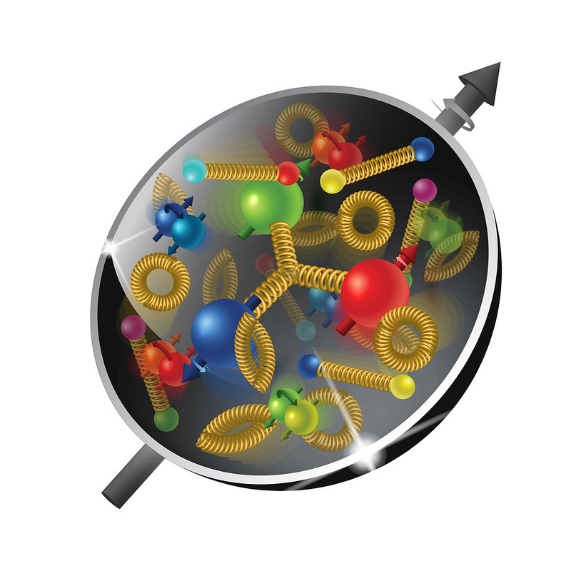
The menu
What is 3D structure?
Why to be excited about it?
Why the Electron-Ion Collider?
Our group consists of theorists and experimentalists.
I will try to provide useful information for all.

Slide 3
The plan
Lecture I:
Structure of the nucleon
Transverse Momentum Dependent distributions (TMDs)
Semi Inclusive Deep Inelastic Scattering (SIDIS)
Calculations of SIDIS structure functions in google colab
Lecture II:
Solution of TMD evolution equations
Collins-Soper-Sterman (CSS) formalism
Lecture III: Giuseppe Bozzi
Phenomenology of unpolarized TMDs

Slide 4
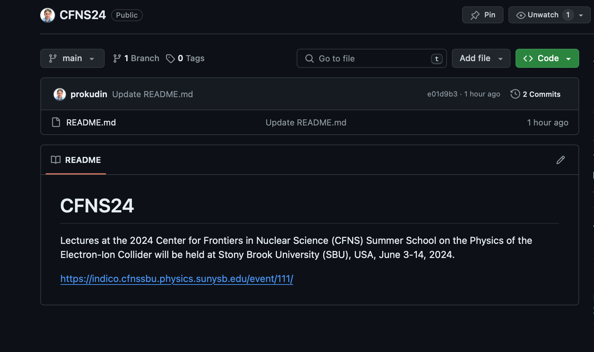
material
https://inspirehep.net/literature/2650019
https://github.com/prokudin/CFNS24
Clone the repository, or download files from github

Slide 5
Tmd table

Slide 6
Transverse momentum dependent distributions

Slide 7
Transverse momentum dependent distributions

Slide 8
Semi inclusive deep inelastic scattering

Slide 9
Semi inclusive deep inelastic scattering

Slide 10
Semi inclusive deep inelastic scattering

Slide 11
Semi inclusive deep inelastic scattering

Slide 12
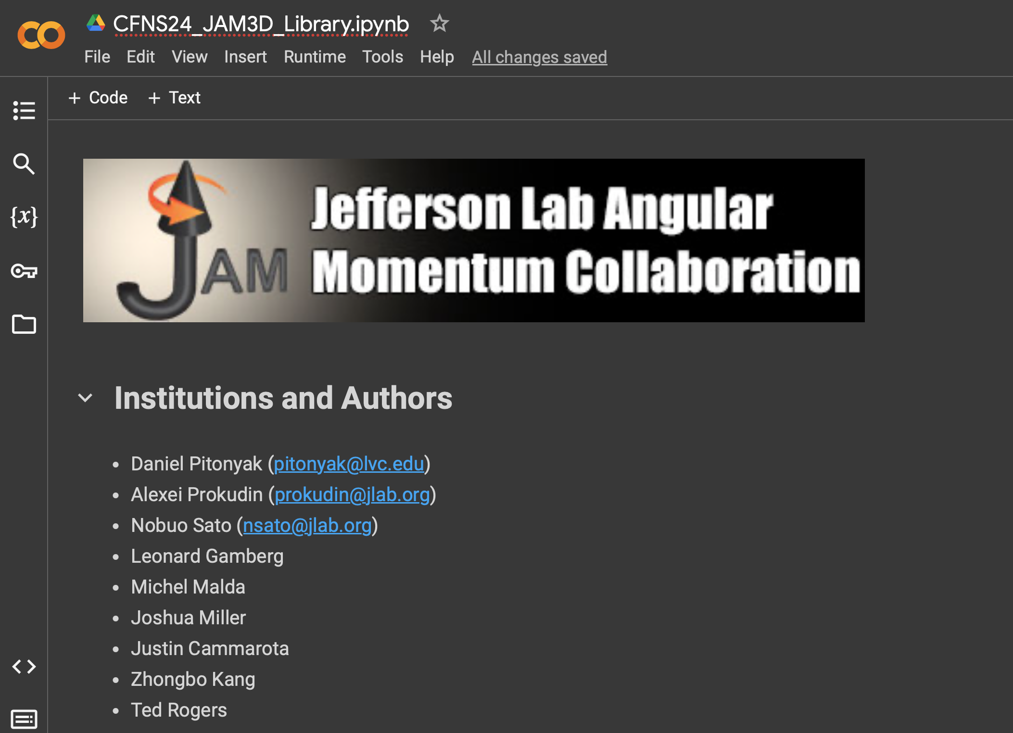
Notebook example

